Slide 1
Óbuda University
Donát Bánki Faculty of Mechanical and Safety Engineering
Guidance for Stipendium Hungaricum and Self-supporting students

Slide 2
Faculty’s SH coordinator
Dr. Ancza Erzsébet, Vice Dean for Education
Contact information:
ancza.erzsebet@bgk.uni-obuda.hu

Slide 3
Mechatronics Institute
Internship related questions
Diploma work
State exam
Head of the Institute: Dr. habil. Laufer Edit
Administrator: Stein Bálint/stein.balint@bgk.uni-obuda.hu

Slide 4
Patronizing professors
Dr. Hanka László (BSc students)
Contact information: hanka.laszlo@bgk.uni-obuda.hu

Slide 5
Mentor Program
first-year students may apply and choose a mentor: https://shmentor.hu/
The mentors' responsibility is to assist their mentees in administrative and educational tasks and to help them in getting used to Hungarian transportation, culture, and norms

Slide 6
These mentors always attend the same university as their mentees and are there for them to provide help with their problems.
Head of the program at Bánki Faculty: Horváth Gergő
Contact information: horvath.gergo@hok.uni-obuda.hu

Slide 7
Registrar’s Department
The Registrar’s Department is located on the ground floor (room 53) of the Faculty’s building
Student opening hours:
Monday | 08:45-11:45
Tuesday | CLOSED
Wednesday | 08:45-11:45 and 13:15-14:30
Thursday | CLOSED
Friday | 08:45-11:45

Slide 8
Registrar’s Department
The office is responsible for matters related to student registration, issuing certificates, academic progress reports, transcripts, course registration
Faculty’s SH study coordinator: Ms. Bettina Ildikó Bosák
Contact information: bosak.bettina@uni-obuda.hu

Slide 9
How to apply for permanent student ID card?
If a student stays at Óbuda University longer than 12 months, (full-time students), one cannot have a temporary student certificate without making an application for a permanent student card!!!
Go to a central bureau „Központi Okmányiroda nearby where you have to search the administration for student IDs
There they will take a photo of you and have your main data registered. You get a form with a unique code in the top right corner called NEK identifier.
Please double check all your data on the issued NEK-document! The data on the NEK document have to be exactly the same as the data registered in the Neptun system (if not, your student card request will be rejected)!

Slide 10
How to register the application in Neptun?
In the upper right corner of the NEK datasheet, you will find a series of numbers, a code. This number must be entered into the Neptun system
Administration > Student card request > Add new … Select first application and type in the NEK number without the hyphens.
As soon as the card is available, your study coordinator is going to inform you via Neptun message
Every semester, you will get a Neptun message about validating your student ID card

Slide 11
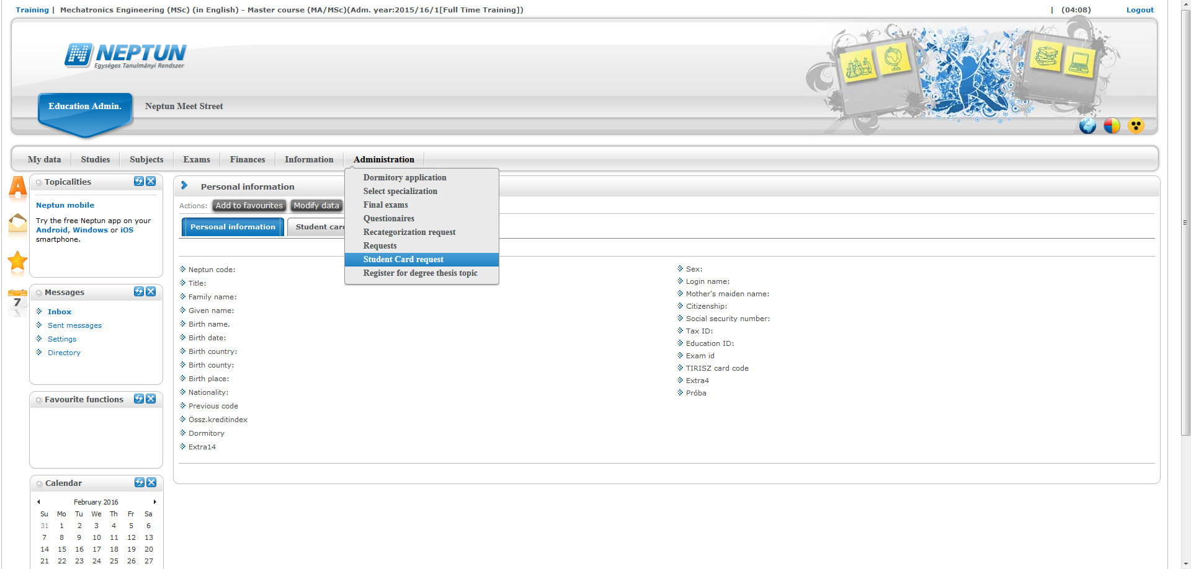
Step 1.
How to register the NEK number in Neptun?

Slide 12
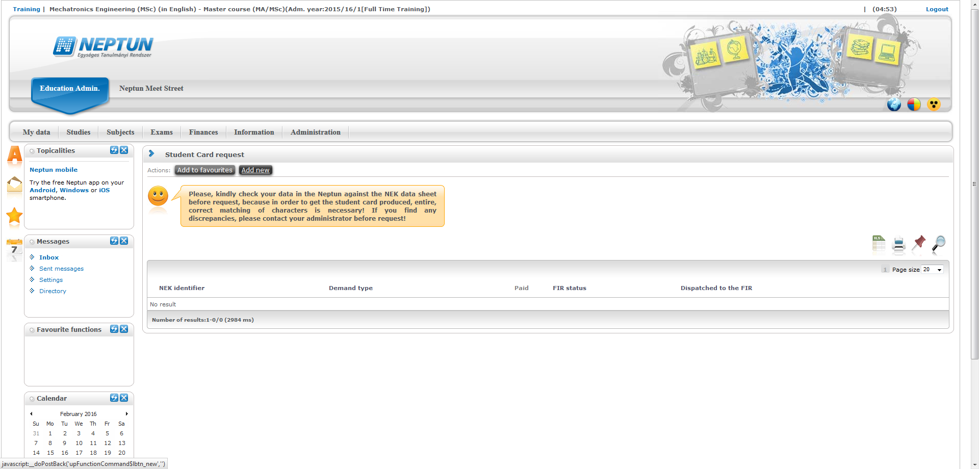
Step 2.
Click here

Slide 13
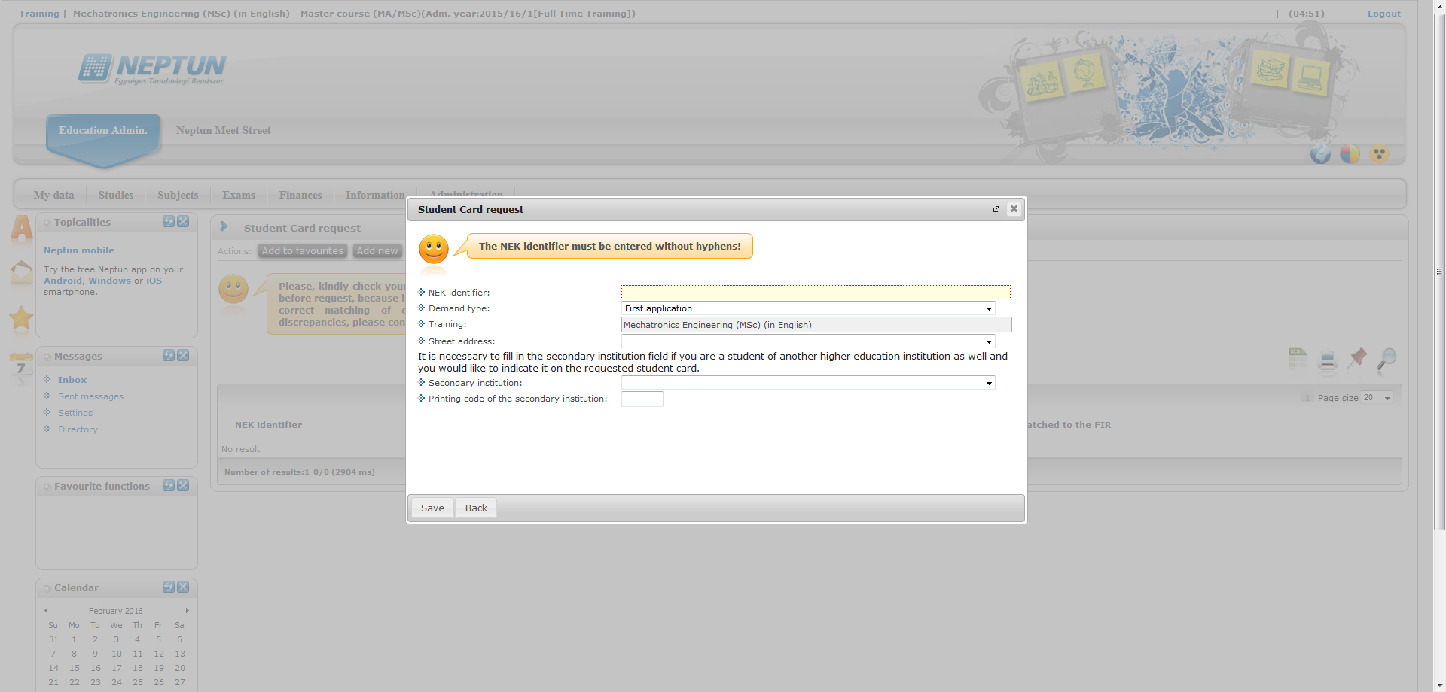
Step 3.
Type in NEK number
Permanent address= home country’s address!
Click here!

Slide 14
Transferring money to Neptun account
Important note! You should place money to Neptun account at least 3 working days before you want to make any money payment in Neptun!
Placing money to your Neptun account does not mean you paid the necessary payments!
An account owner’s name: Óbudai Egyetem
Bank: MBH Bank Nyrt. (MBH)
IBAN code: HU16 10300002-13268139-00024900
SWIFT code: MKKBHUHBXXX
For Hungarian bank accounts: 10300002-13268139-00024900
Comment/description of the bank transfer: you have to specify „NK-XXXXXX, FULLNAME”, where XXXXXX is your Neptun code, for example: NK-UNR05O, Charlotte Brontë

Slide 15
The process of retake exam
Prices
4.000,- HUF / Retake exam, of only third exam. You can register two exams/one semester (free of charge)
4.000,- HUF / repeat mid-term mark, or Teacher’s signature
If you have already taken the exam and the retake exam once, then you will have to pay for all further exam opportunities in the future, before being able to register for any subsequent exams

Slide 16
Item transcription
To transcribe a retake exam fee or signature supplement fee, go to the Finances / Payment and click on the “Transcribe item” box
A “Transcribe item” window will pop up, here you have to select the inpayment title: “Retake exam” item or a “Service”
If you have set everything correctly, then click on the “Create item” button
See the screenshots below!

Slide 17
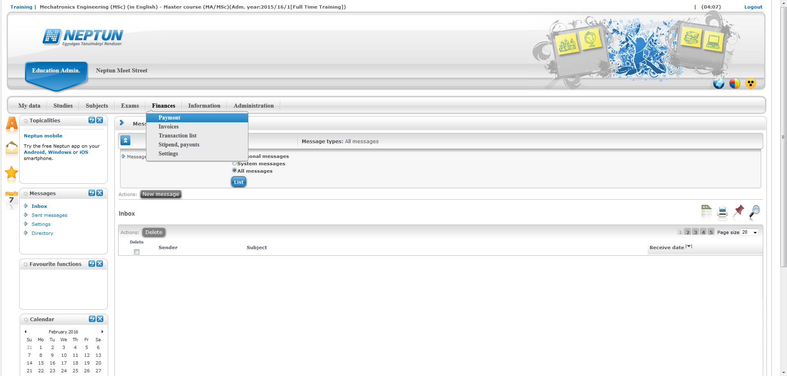
Step 1

Slide 18
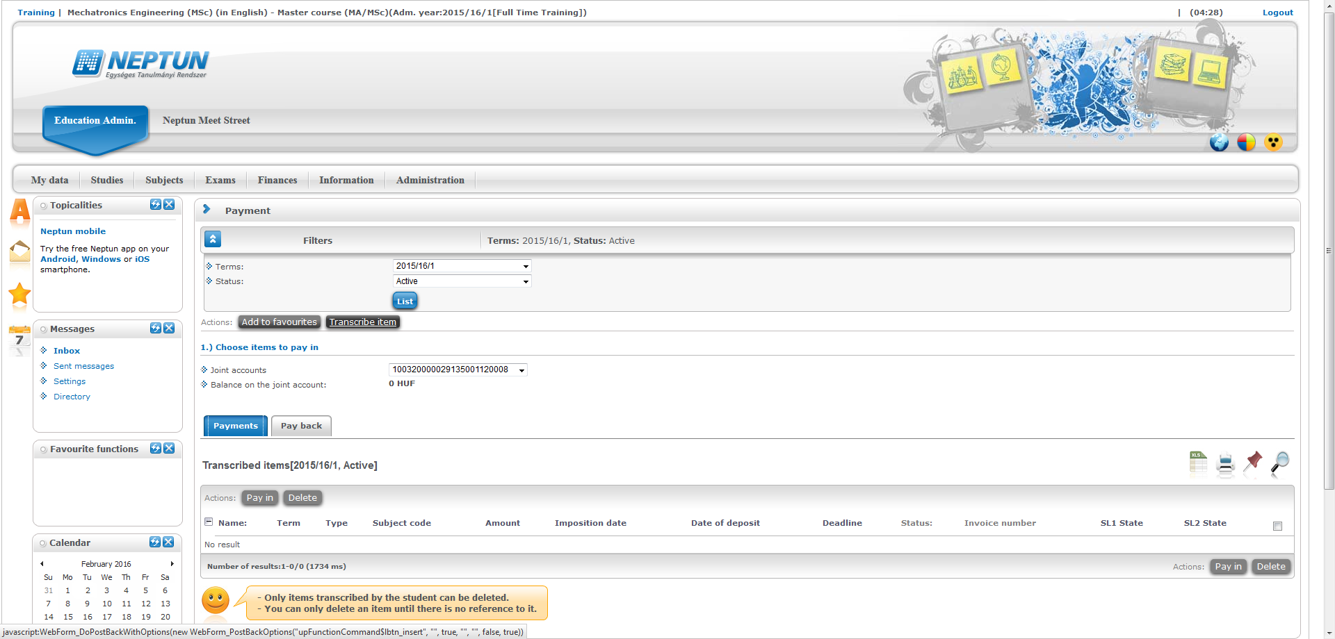
Step 2
Click here!

Slide 19
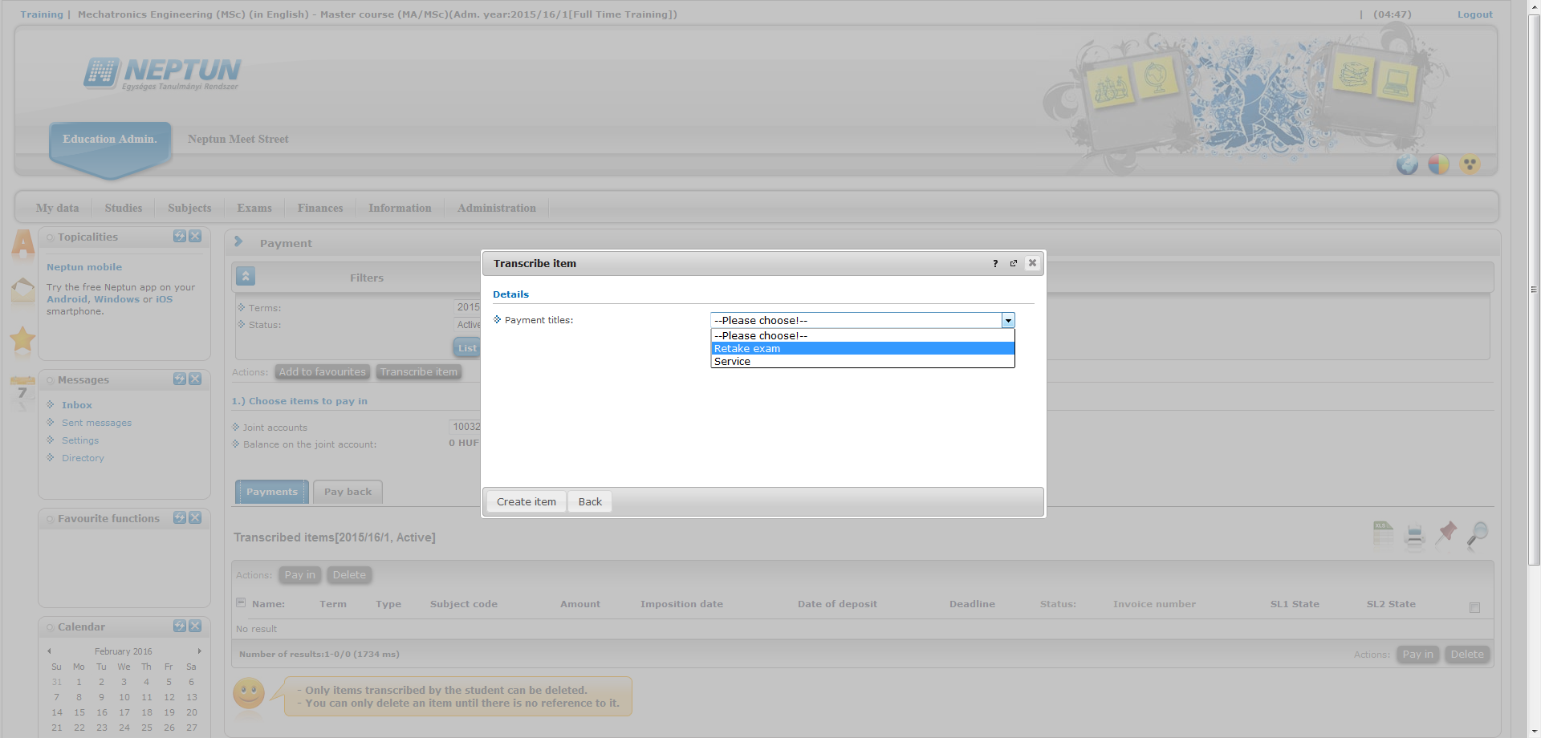
Step 3

Slide 20
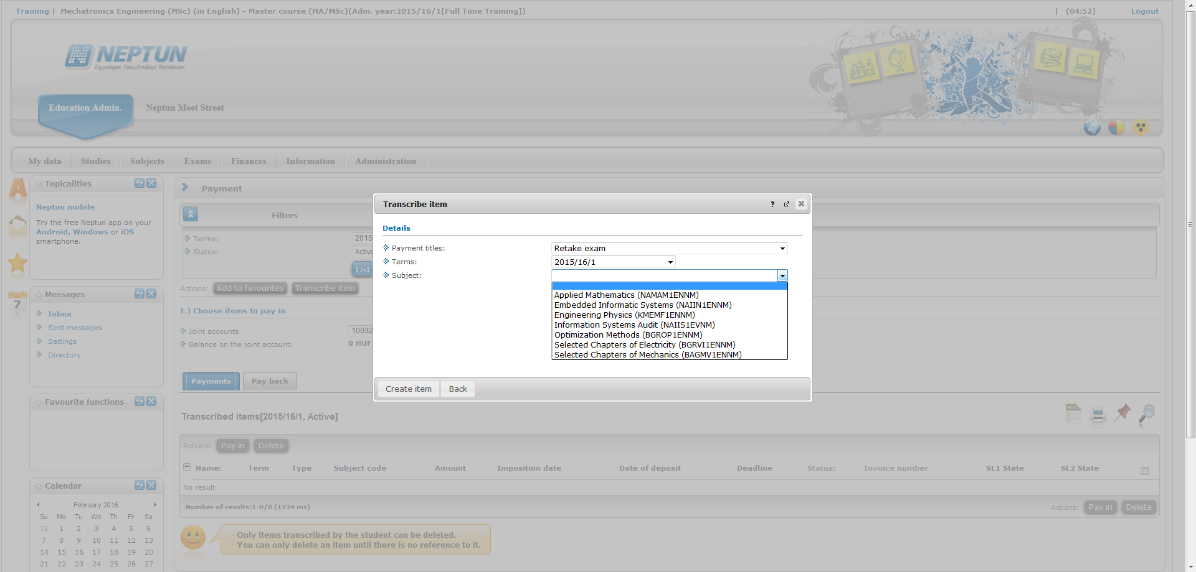
Step 4

Slide 21
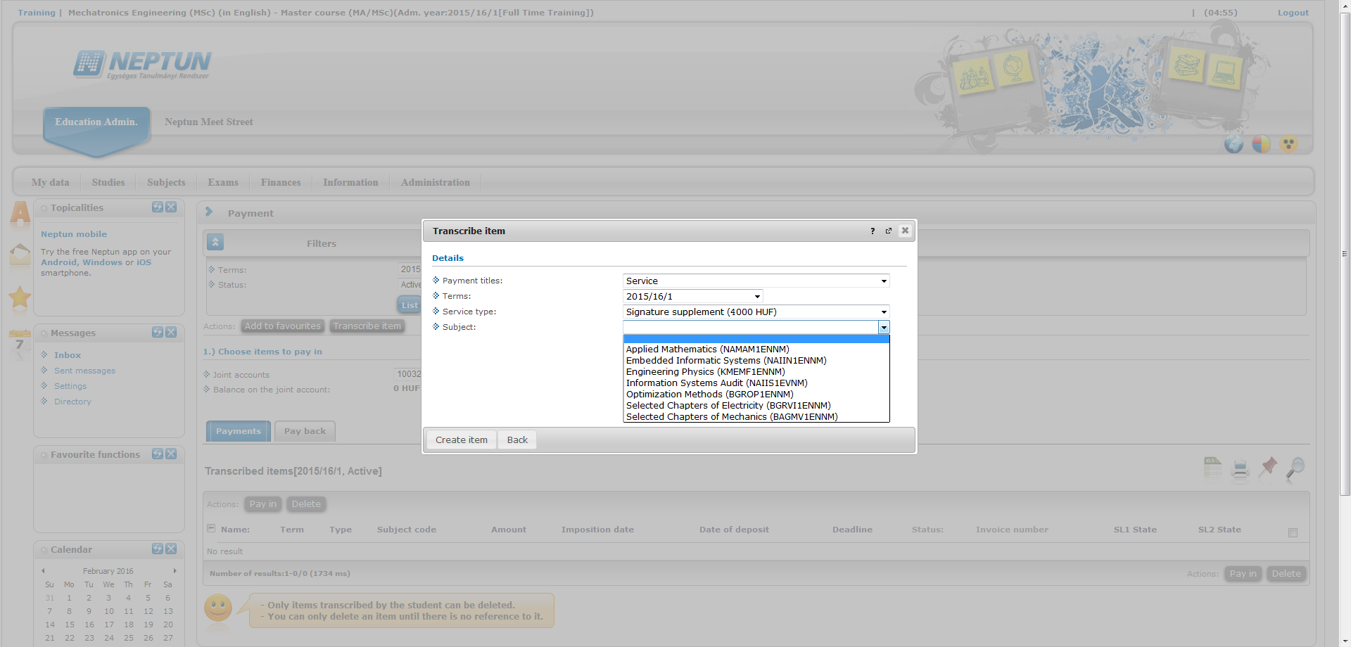
Choose „Service” for Signature supplement!

Slide 22
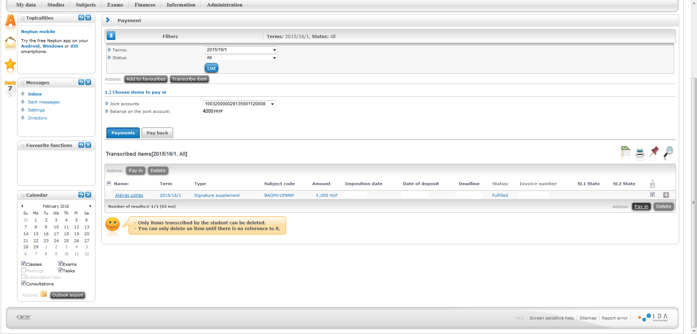
Tick box!
Click on Pay in!

Slide 23
Dismissal
Student Requirement System of Óbuda University
CHAPTER IV - TERMINATION OF THE STUDENT RELATIONSHIP
Section 27.
The student relationship shall terminate:
f) if the student relationship of a student in payment arrears is terminated by the Rector after an unsuccessful demand for payment and an examination of the student’s welfare status, on the day of the decision on termination of the student relationship becoming final.
(2) In the event that, following the uninterrupted suspension of the student relationship for two semesters, a student fails to register to an active semester in the absence of the Dean’s permission.

Slide 24
(4) The University shall also terminate the student relationship by a unilateral statement in case of students:
who fail to fulfill their obligations relating to academic progress as set out in the study and examination regulations and in the curriculum, particularly if, after 4 active semesters following the student’s matriculation, the number of credit points acquired stays below 55 credits at a regular course, and 40 credits at an evening, correspondence, and distance training course (such credits to include, as a maximum, the credit value of optional subjects indicated in the model curriculum),
where the aggregate number of failed and repeated retake examinations in the same unit of study – requiring an examination to be passed – has reached five (meaning that there are 6 opportunities to take an examination of the same subject).
f) where the aggregate number of fail marks in the same unit of study – requiring a midyear grade – has reached six (meaning that up to 5 fail marks can be received as midyear grades).

Slide 25
Should you need any further information, please contact the faculty’s study coordinator at bosak.bettina@uni-obuda.hu!

